Slide 1

[+] Green is Good 558ms
[-] Red is Bad 168ms
Turning Your Checklists
into Pester Tests
Rob Sewell @sqldbawithbeard https://sqldbawithAbeard.com

Slide 2
speaker questionnaire
Name : Rob
Occupation : DBA, Automator, Do-er, Trainer, DevOpser!
Available for hire ☺ - RobSewell.info
Interests : PowerShell, Automation And SQL (PaaS geddit?)
Interesting Fact : Beard. (Still) Plays Cricket, Flies Drone
Speaker : SQL Saturdays, SQL Relay, PowerShell Events
Community : SQL South West , SQL Sat Exeter , PowerShell VG, PowerShell Conference EU Organiser, dbareports, dbatools, SQLDiagAPI – For Consuming SQL Server Diagnostics API, MVP
Crashes

Slide 3
TODAY’s TO DO LIST
GET UP
Drink Appropriate Liquid
The Rest

Slide 4
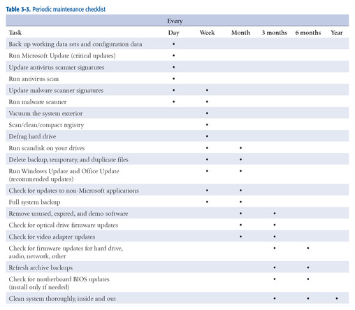
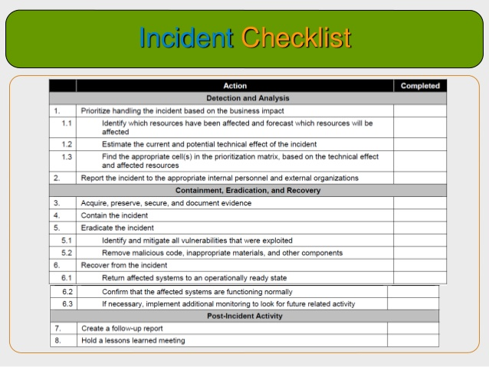
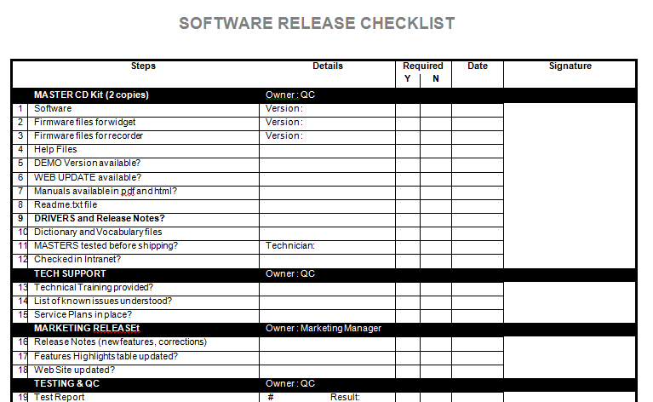
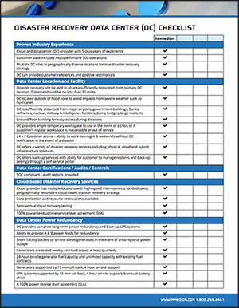
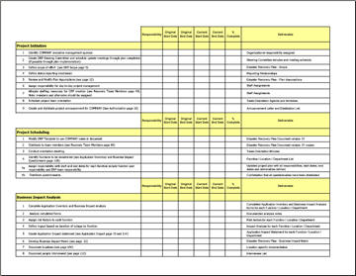
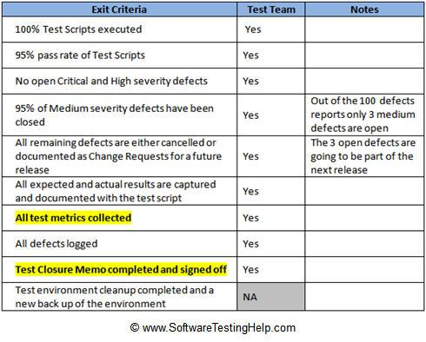
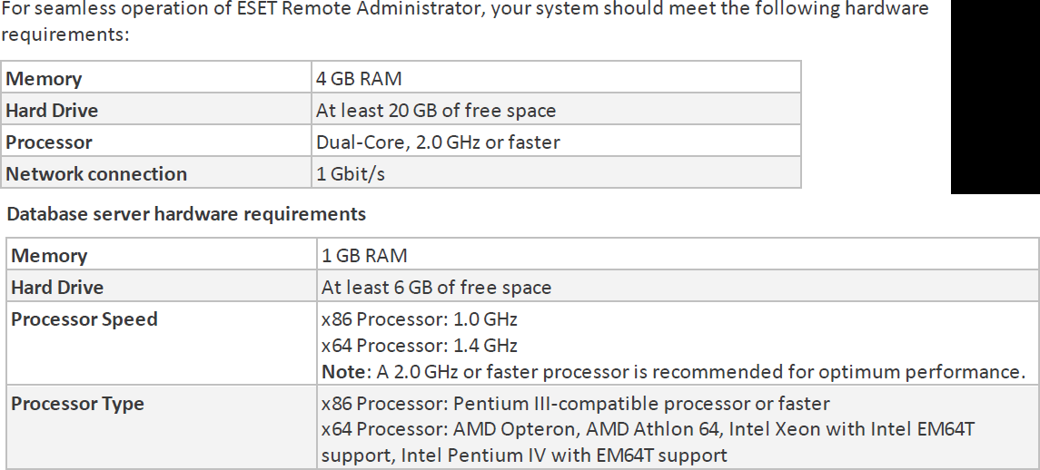
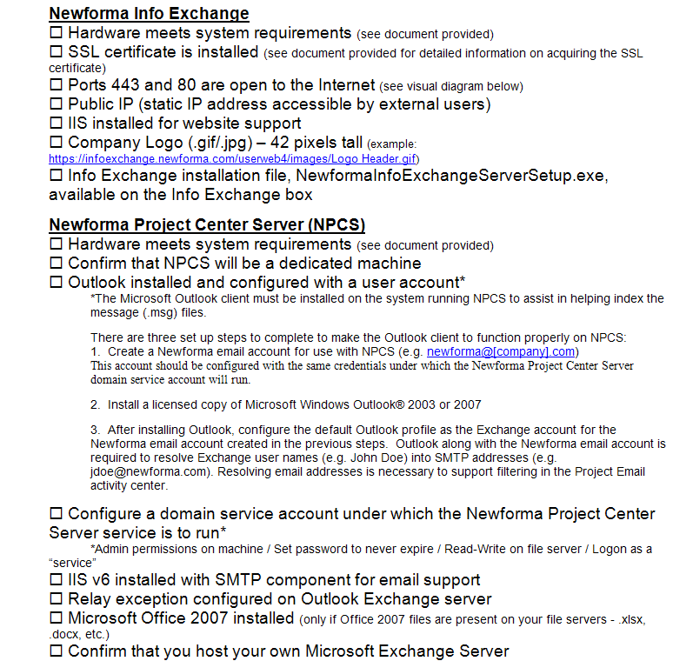
How Many Checklists Do You Have?
Notes:
I bet there are checklists for
New servers/ data centers
Hardware/software installations
Incident Response
1st Line/2nd line for systems
Pre-requisites
Morning routines

Slide 5
What about
Demos
Presentations
Morning Checks
Incident Response
First Line Support
I‘m sure you are already thinking of more

Slide 6











Sponsors!

Slide 7
Sponsors!

Slide 8
What is Pester?
Pester provides a framework for running unit tests to execute and validate PowerShell commands from within PowerShell
https://github.com/pester/Pester
Notes:
Its used for unit testing or TDD but can also be used to validate an environment. Comes with Windows 10 or install from the gallery with Install-Module Pester

Slide 9
What Does it Look Like?
Notes:
This is a Pester test running in VS Code

Slide 10
I’m Sorry!

Slide 11
Should Operators
Be Compares one object with another for equality. Case Insensitive BeExactly Compares one object with another for equality. Case Sensitive BeGreaterThan Asserts that a number is greater than an expected value. BeLessThan Asserts that a number is less than an expected value. BeLike Asserts that the actual value matches a wildcard pattern using -like operator. Case Insensitive BeLikeExactly Asserts that the actual value matches a wildcard pattern using -like operator. Case Sensitive BeOfType Asserts that the actual value should be an object of a specified type Exist Does not perform any comparison but checks if the object calling Exist is present in a PS Provider. Contain Checks to see if a file contains the specified text. Case Insensitive ContainExactly Checks to see if a file contains the specified text. Case Sensitive Match Uses a regular expression to compare two objects. Case Insensitive MatchExactly Uses a regular expression to compare two objects. Case Sensitive Throw Checks if an exception was thrown in the input ScriptBlock. BeNullOrEmpty Checks values for null or empty (strings).
I Hate slides with lots of text but I think this one is valid

Slide 12

So What Can You Validate?
Notes:
Everything in the world ☺

Slide 13
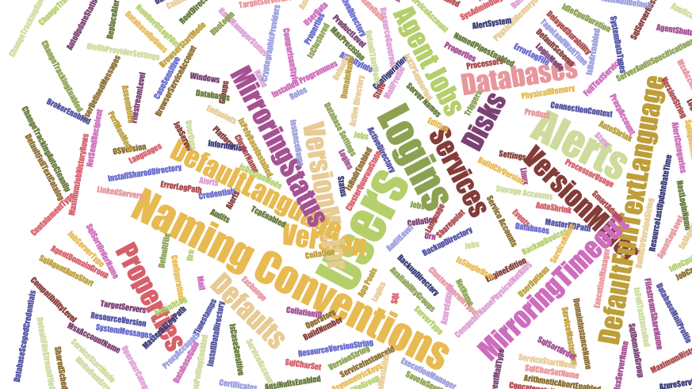
Maybe not EVERY thing but anything you can check with PowerShell

Slide 14

Maybe not EVERY thing but anything you can check with PowerShell
Which Does NOT include
Describe “Bag Packing” {
Context “Hardware”{
It “Bag Should include BeardNUC” {
$bag.Contents –contains ‘beardnuc’ | Should Be $True
}
}
}
I have no virtual machines with me here!
dumskalle!

Slide 15

Hey Beardy!
Time For A DEMO

Slide 16
Summary
We all have checklists – manual testing is error-prone
Pester is a Unit Testing Framework for PowerShell
You can use it to validate your infrastructure
The basic syntax - Describe, Context and It code blocks
The Should command is used for testing assertions
Use the NunitXML output and the reportviewer.exe to make HTML reports or Export to JSON and use PowerBi
Rob Sewell @sqldbawithbeard https://sqldbawithAbeard.com

Slide 17
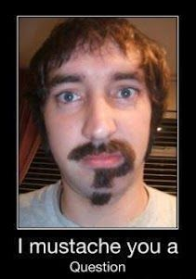
Questions?
?
?
?
?
?
?
?
?
?
?
?
?
?
?
?
?
Rob Sewell @sqldbawithbeard https://sqldbawithAbeard.com

Slide 18
Further Reading
Adam Bertram – The Pester Book
https://leanpub.com/pesterbook
Rob Sewell and Andre Kamman at PSConfEU
https://www.youtube.com/watch?v=8Nljk1deSmU&t=188s
Rob Sewell @sqldbawithbeard https://sqldbawithAbeard.com

